Slide 1
Employee Data Analysis using Excel
STUDENT NAME: DALLIN BENITTA.B
asunm110UNM110312201314
DEPARTMENT: COMMERCE
COLLEGE: DRBCCC HINDU COLLEGE

Slide 2



PROJECT TITLE
Employee Salary Analysis using Excel

Slide 3



AGENDA:
Problem Statement
Project Overview
End Users
Our Solution and Proposition
Dataset Description
Modelling Approach
Results and Discussion
Conclusion
3/21/2024 Annual Review

Slide 4

PROBLEM STATEMENT Analyzing employee salaries helps ensure fair compensation, identify wage disparities, and align pay structures with industry standards. It also aids in budgeting and financial planning, ensuring that salary expenses are sustainable.

Slide 5

PROJECT OVERVIEW The Employee Salary Analysis project aims to evaluate and optimize employee compensation within the organization. This involves collecting, cleaning, and analyzing salary data to identify trends, disparities, and correlations with factors such as job roles, performance, and experience. The analysis will help ensure competitive and fair compensation, inform HR policies, and support budget planning. The project will conclude with actionable insights and recommendations for salary adjustments.

Slide 6


WHO ARE THE END USERS? -HUMAN RESOURCES(HR) -MANAGEMENT & EXECUTIVES -FINANCE DEPARTMENT -TEAM LEADER -EMPLOYEES

Slide 7

OUR SOLUTION AND ITS VALUE PROPOSITION CONDITIONAL FORMATTING-SALARY FILTER-REMOVE FORMULA-PERFROMANCE GRAPH- DATA VISUALIZTION

Slide 8
Dataset Description EMPLOYEE DETAILS-KAGGLE.COM 30-FEATURES 11-FEATURES NAME-TEXT JOINING YEAR-NUMBERS GENDER-MALE OR FEMALE AGE-NUMBERS SALARY-NUMBERS WORK LOCATION-TEXT EMPLOYEE RATING-NUMBERS PERFORMANCE-TEXT

Slide 9

THE "WOW" IN OUR SOLUTION PERFORMANCE LEVEL =IFS(J3>=5,"Very High",J3>=4,"High",J3>=3,“MED",TRUE,"LOW")
3/21/2024 Annual Review
9

Slide 10
MODELLING
DATA COLLECTION:
●COLLECTED FROM KAGGLE.
FEATURE COLLECTION:
●CONDITIONAL FORMATTING
● SYMBOLS
●MERGE&CENTER
PERFORMANCE LEVEL:
●WITH USING EMPLOYEE RATING COLUNM TO GET PERFORMANCE LEVEL.
10

Slide 11
SUMMARY:
● TO FIND THE SALARY OF THE EMPLOYEE BY USING THE EXCEL
●THE RESULTS SHOWN IN THE GRAPH.

Slide 12
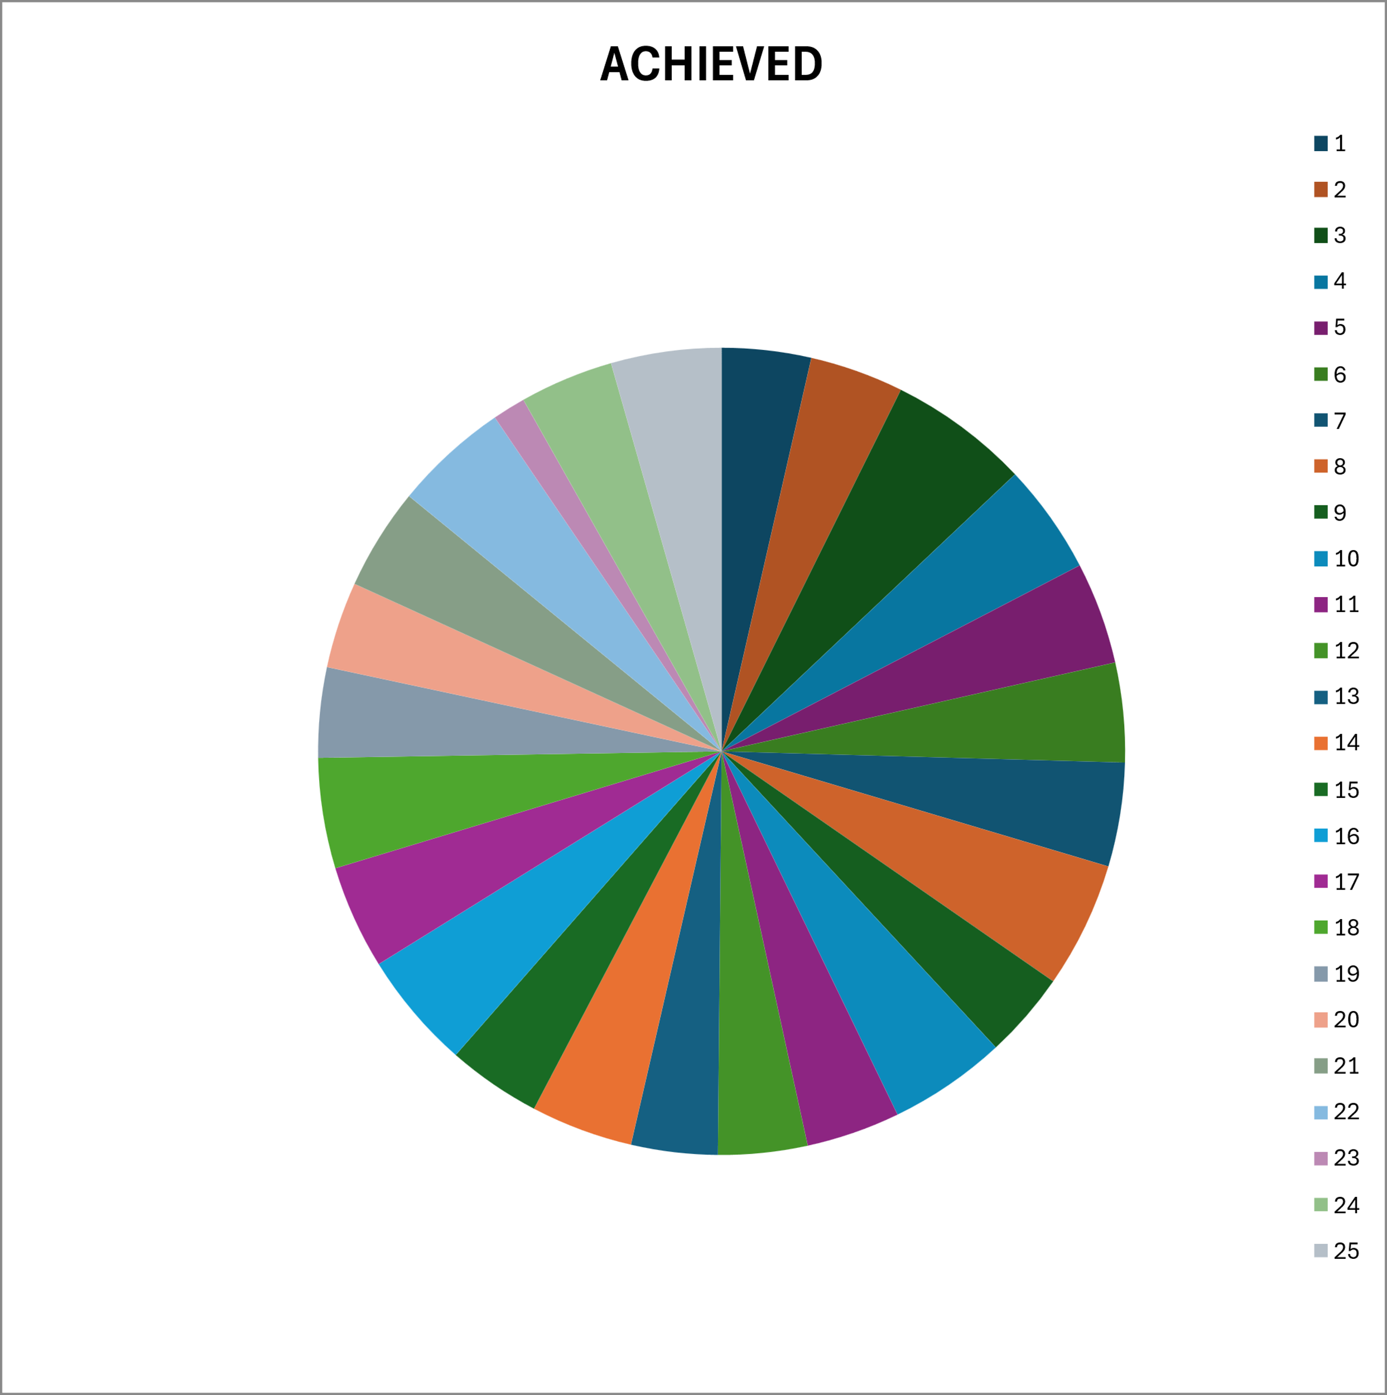
RESULTS:
12

Slide 13
CONCLUSION: IN THIS SALARY ANALYSIS THE SOME OF EMPLOYEES ARE GET HIGHER SALARY IN THE DEPARTMENT OF QUALITY AND SALES.

